Slide 1

Visión por Computador
Domingo Mery
Departamento de Ciencia de la Computación
Escuela de Ingeniería
Universidad Católica de Chile
Good Practices

Slide 2
Explainability

Slide 3
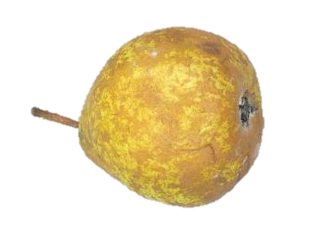
Explainability
It is the concept that a machine learning model and its output can be explained in a way that “makes sense” to a human being at an acceptable level.
Why ?
Trained
Model
'Premium’
Input: image
Output: Class

Slide 4
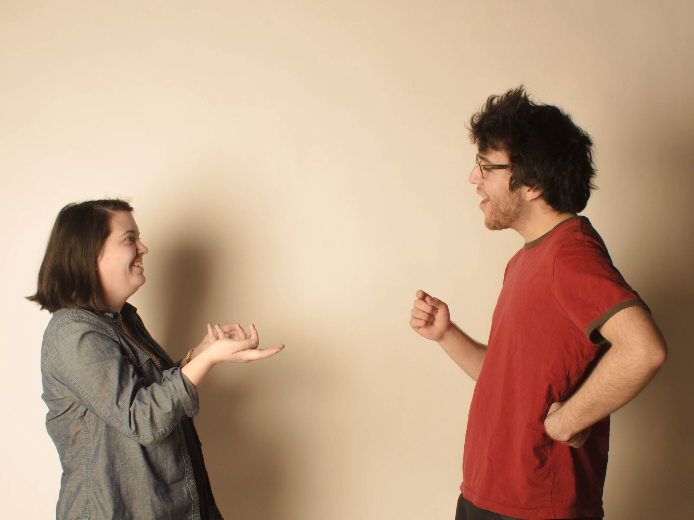
So, tell me, why this fruit is premium?

Slide 5
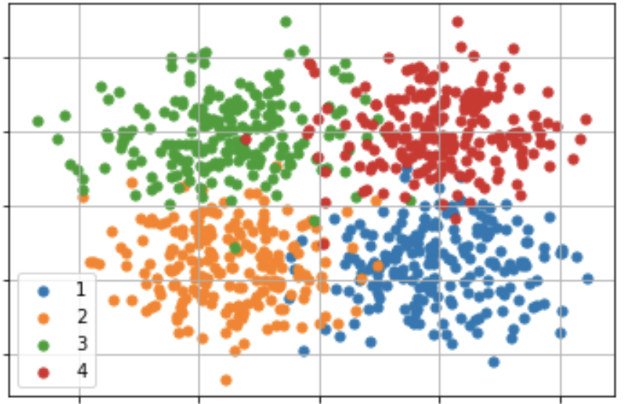
Because it is very sweet and very big

Slide 6
Explainability
It is the concept that a machine learning model and its output can be explained in a way that “makes sense” to a human being at an acceptable level.
Why ?
Trained
Model
'Premium’
Input: image
Output: Class

Slide 7
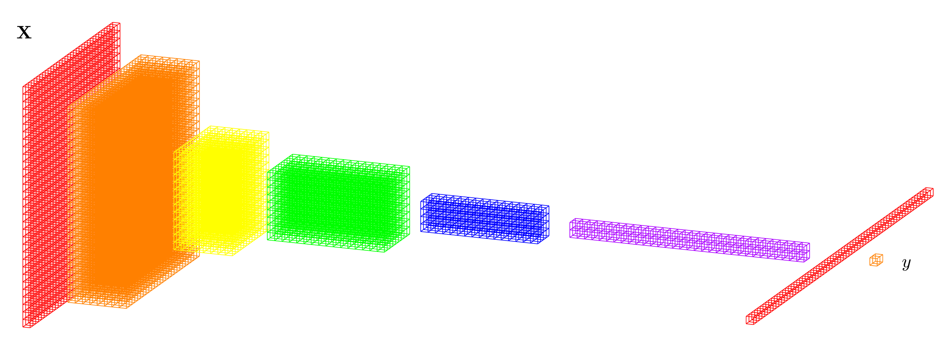
Explainability
It is the concept that a machine learning model and its output can be explained in a way that “makes sense” to a human being at an acceptable level.
CNN
Why ?
'Premium’
Input: image
Output: Class

Slide 8
So, tell me, why this fruit is premium?

Slide 9

Mmmmh, let me see why

Slide 10
Well, we have to analyze millions of parameters

Slide 11
Explainability using Perturbation and Saliency Maps:
An Example for `Happiness’ in Facial Analysis
Mery, D. (2022). True black-box explanation in facial analysis. In Proceedings of the IEEE/CVF Conference on Computer Vision and Pattern Recognition (pp. 1596-1605).

Slide 12
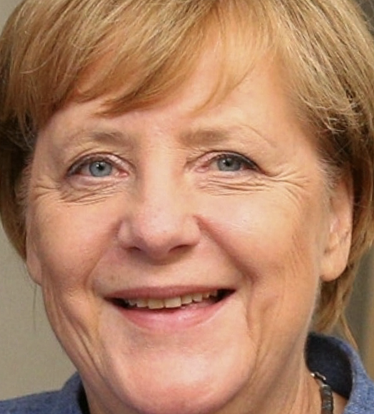
Expression: How `happy´ is this person?
angry | 0.0001
disgust | 0.0000
scared | 0.0005
happy | 0.9723
sad | 0.0026
surprised | 0.0001
neutral | 0.0245
f_{x}
Input
Output

Slide 13
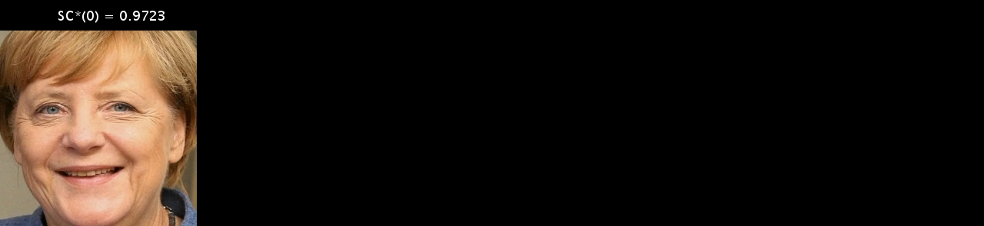
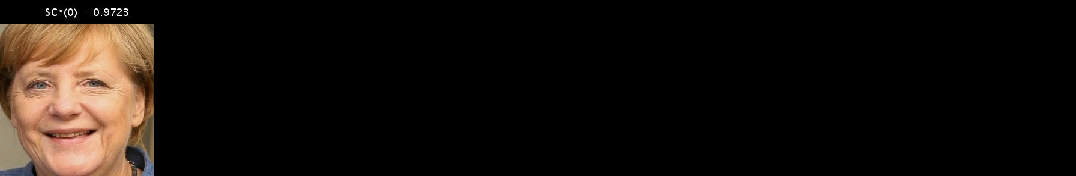



Slide 14
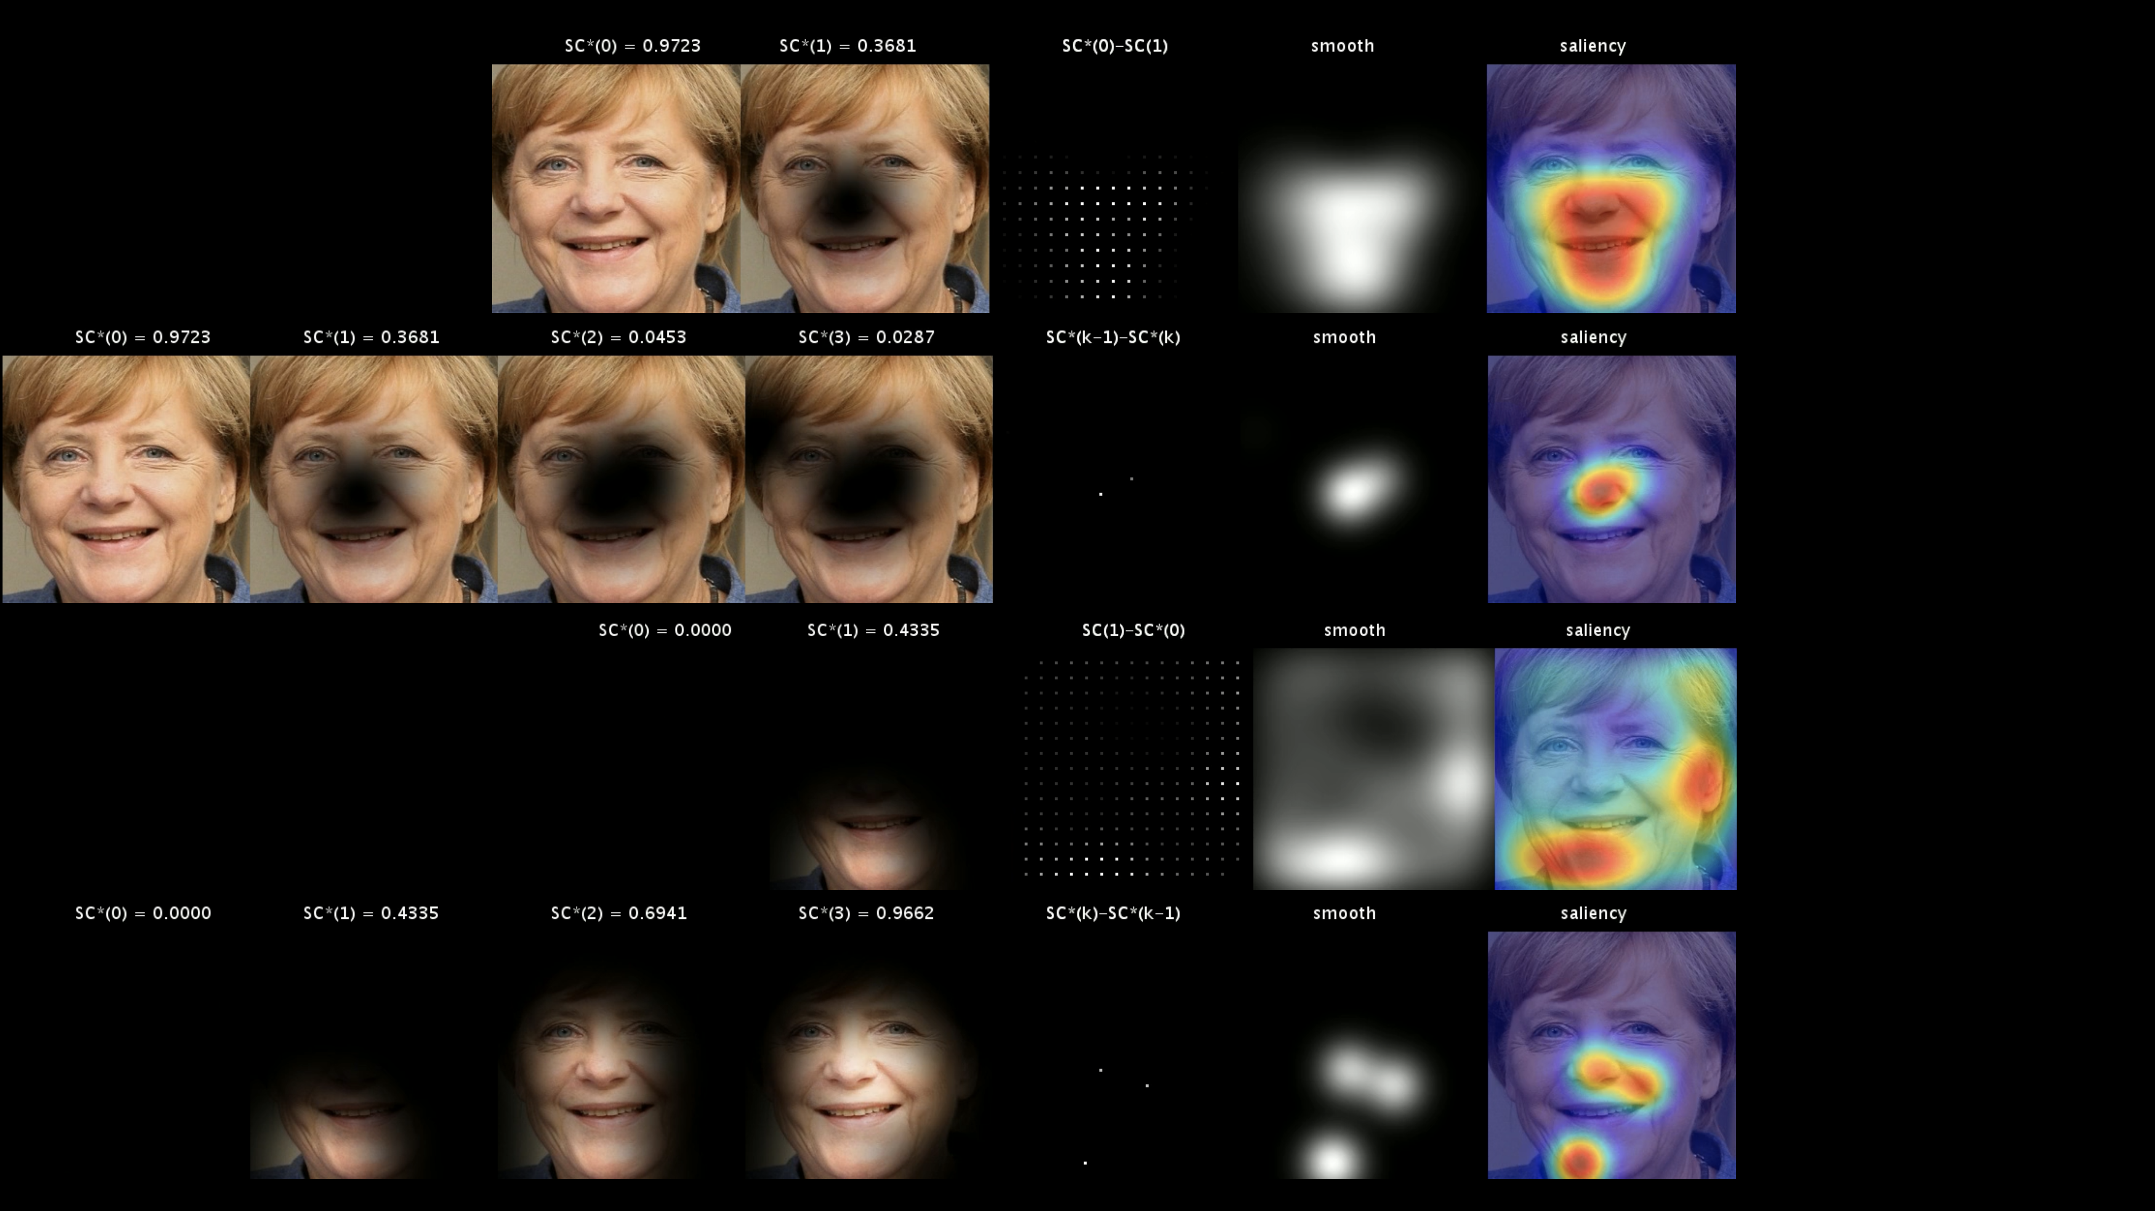
H₀–
H₁–
H₀+
H₁+

Slide 15
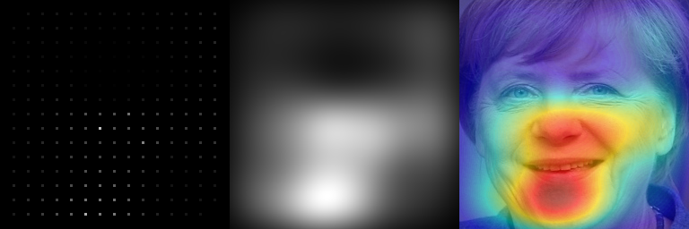
H₀–
H₁–
mean
H₀+
H₁+

Slide 16
H₀–
H₁–
mean smooth
H₀+
H₁+

Slide 17
H₀–
H₁–
mean smooth saliency
H₀+
MinPlus
H₁+

Slide 18
Explanation: Relevant parts of the model for happiness
MinPlus
H₀–
H₀+
H₁–
H₁+

Slide 19
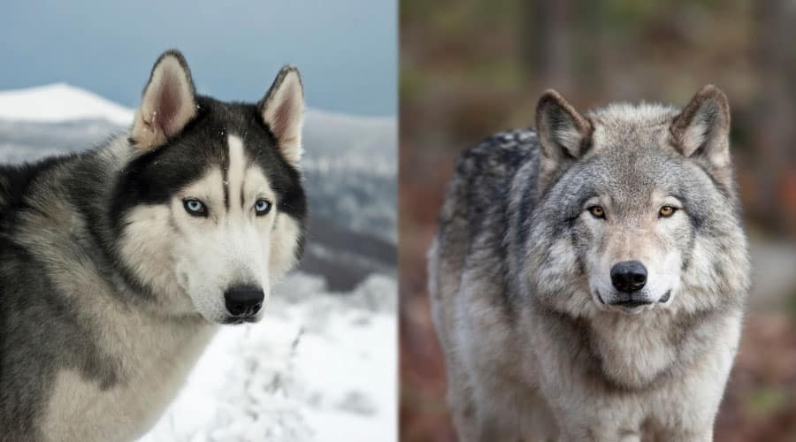
HUSKY
WOLF

Slide 20
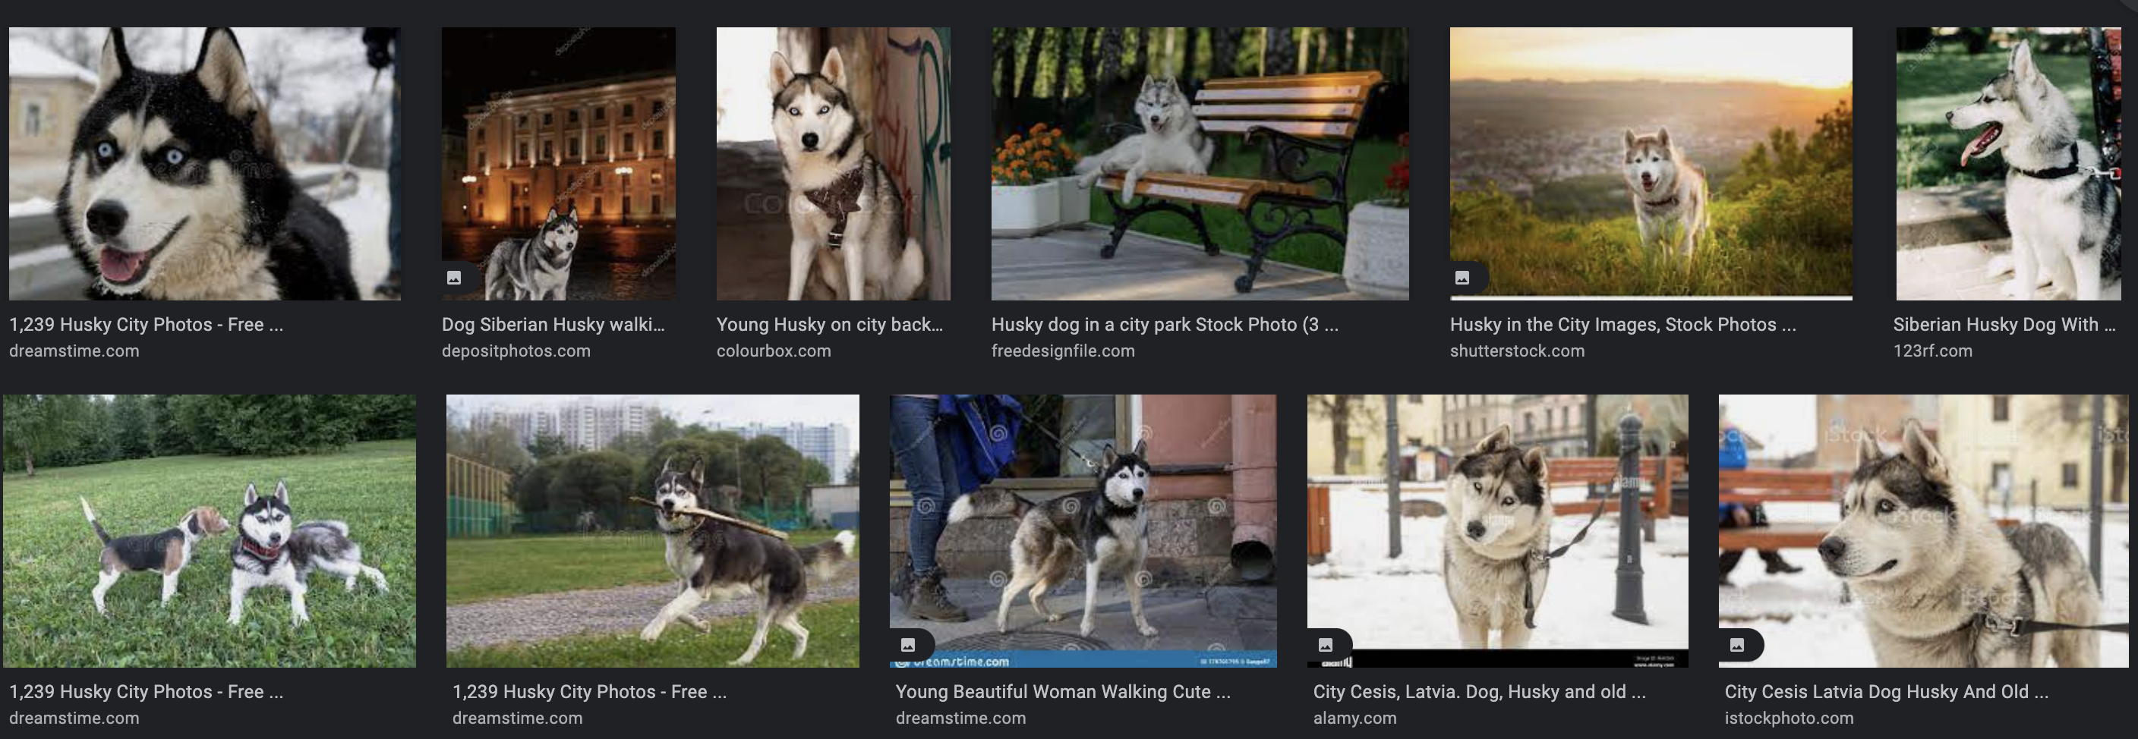
TRAINING DATASET: HUSKY

Slide 21
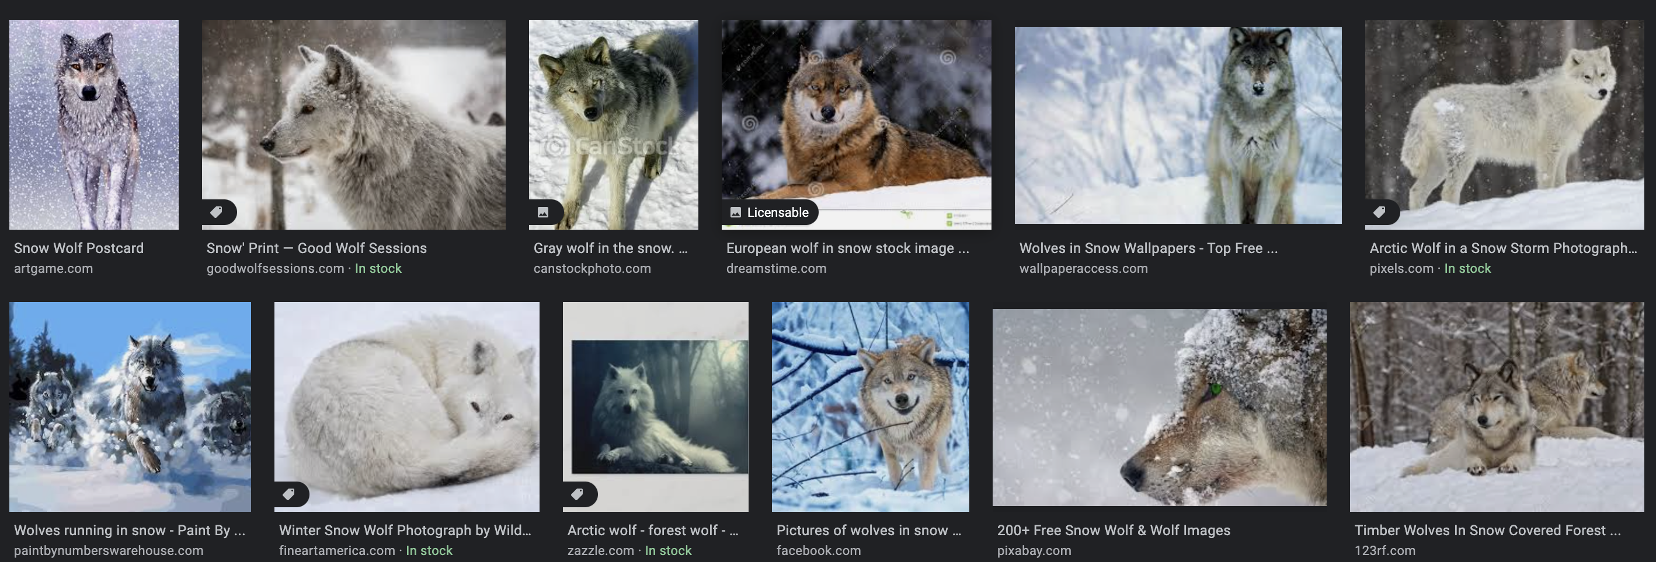
TRAINING DATASET: WOLF

Slide 22
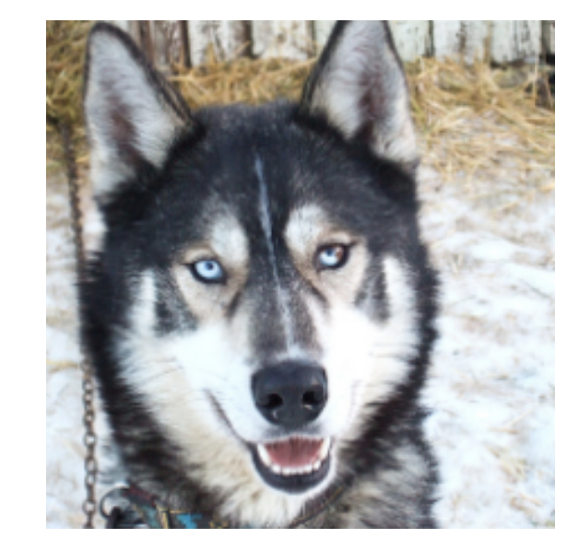
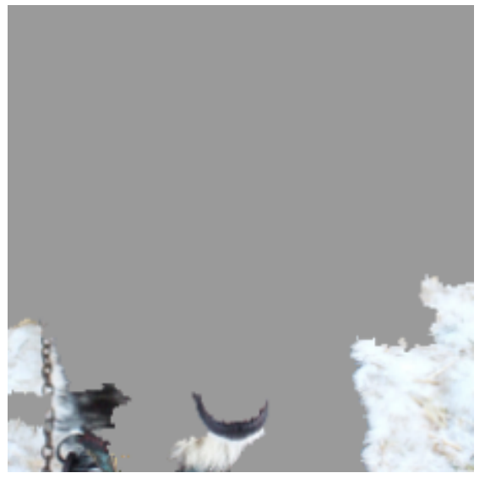
TESTING
SNOW
HUSKY misclassified as WOLF
Explanation
Why ?

Slide 23
Meta-Data

Slide 24
Meta-Data
How can we include Meta-Data into
Computer Vision algorithms?

Slide 25
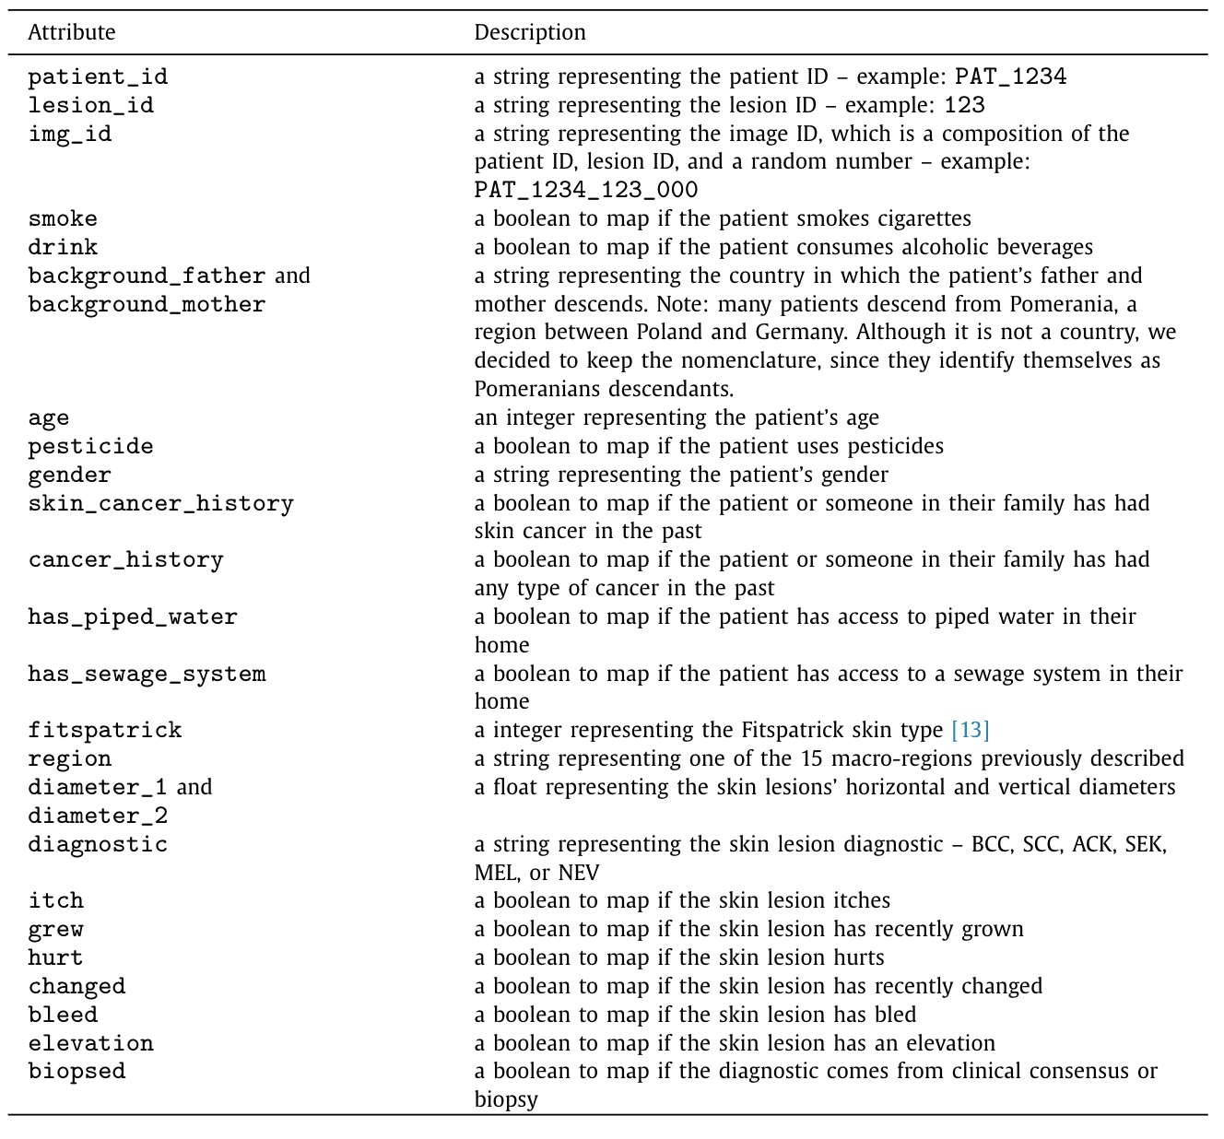
Meta-Data
The question of whether addition of metadata can improve the performance of the models is not well understood.
For example, can we use the age and sex of the patient, and location of the lesion in our model?
It is necessary to know which metadata contributes and which does not contribute to the classification of skin cancer.
Pacecho et al. (2020). Data in Brief

Slide 26
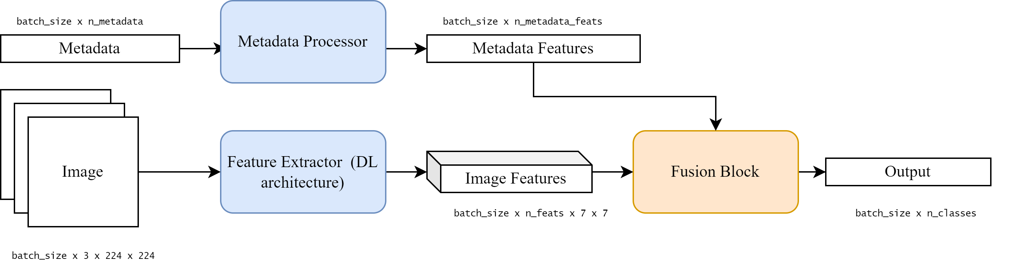
Meta-Data: Fusion Diagram
© Gabriel Garib

Slide 27
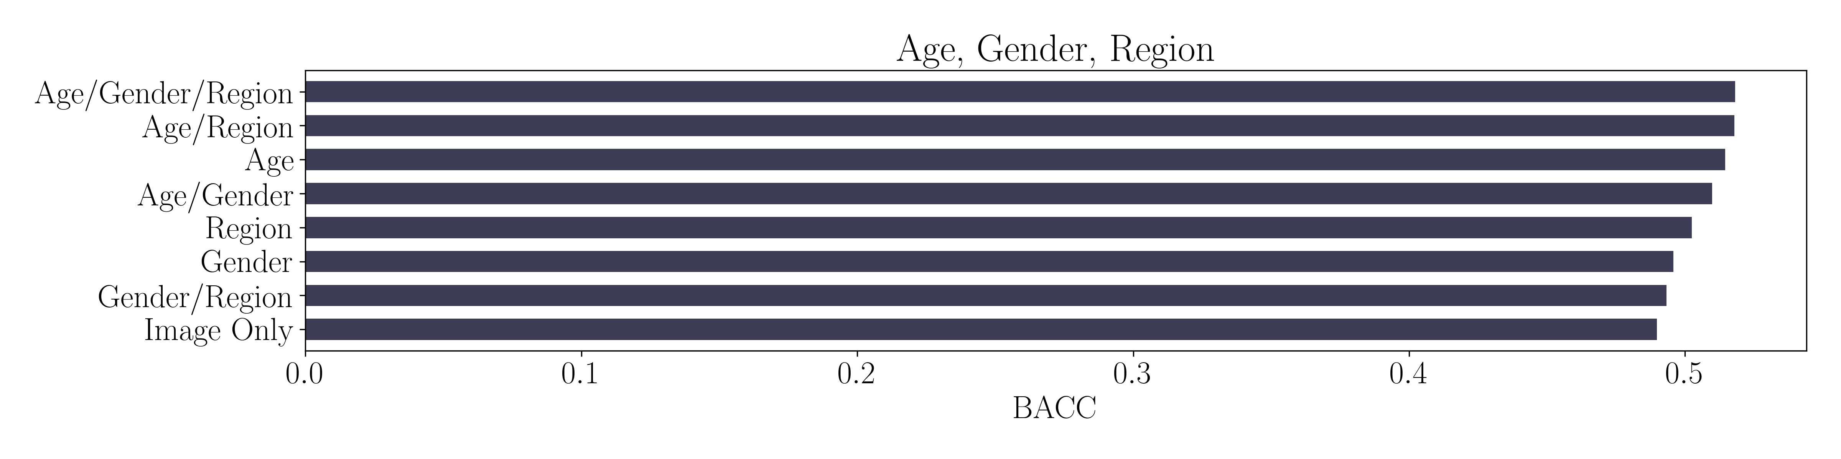
Meta-Data: Experiments
(Skin Lesion Recognition in unbalanced data)
© Gabriel Garib

Slide 28
Privacy

Slide 29
Privacy
How can we improve our models
with data that can be private?

Slide 30
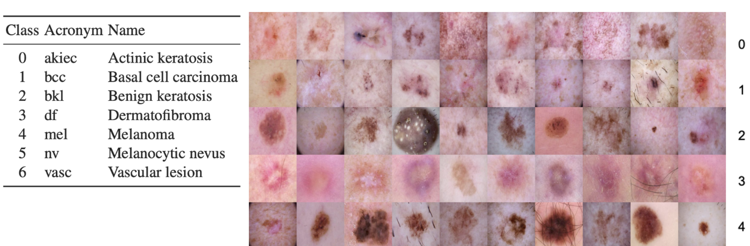
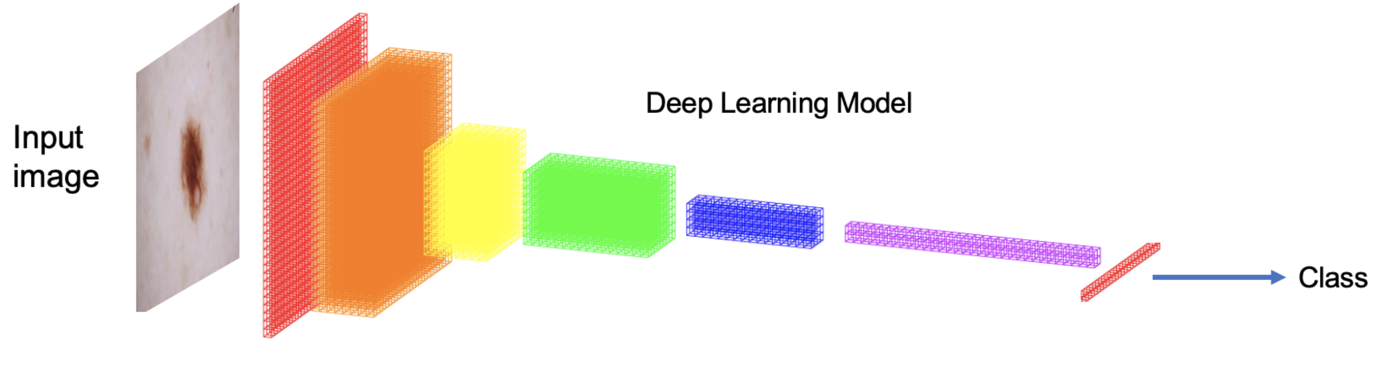
Privacy in:
Skin Lesion Recognition
Datasets
AR (Argentina)
ISIC (International)
CL (Chile)
5250 samples / dataset
1050 samples / class

Slide 31



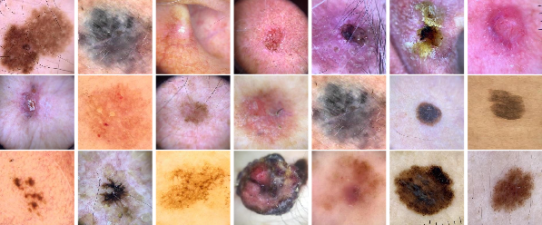
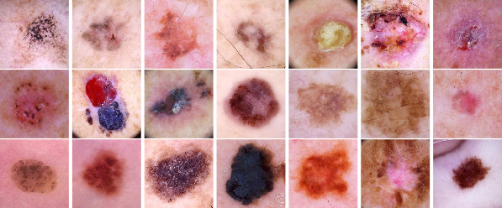
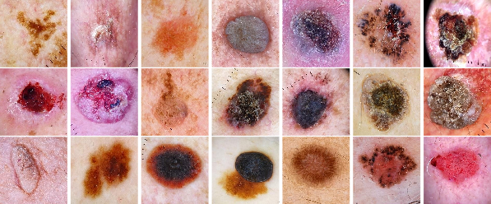



How to share data?
Dermoscopic images
Three Datasets

Slide 32
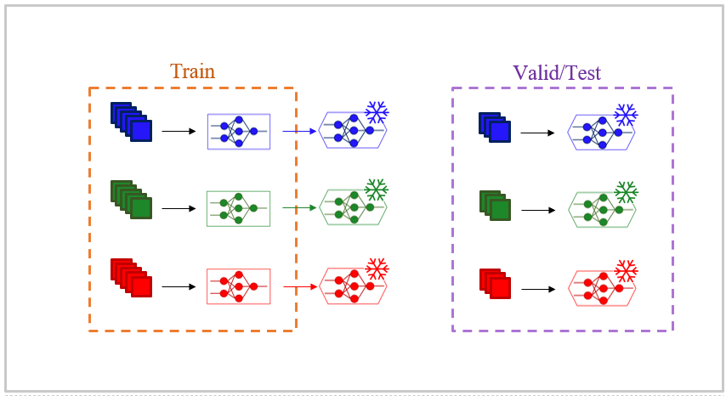
Learning Algorithms: Central Learning

Slide 33
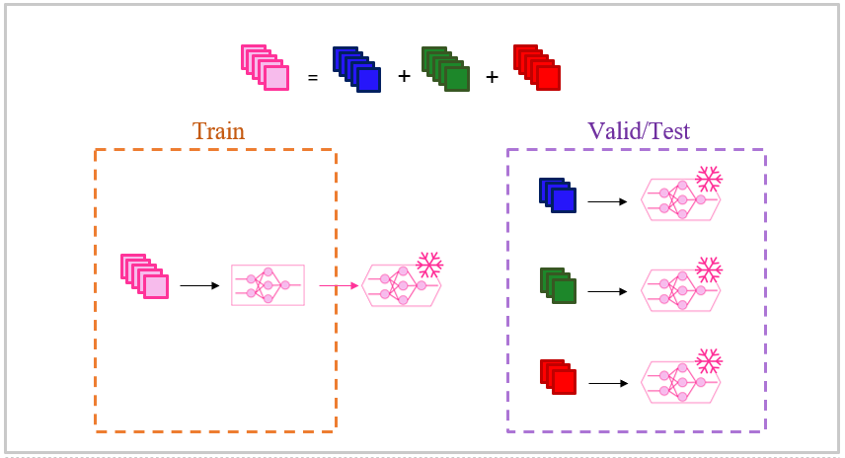
Learning Algorithms: Local Learning

Slide 34
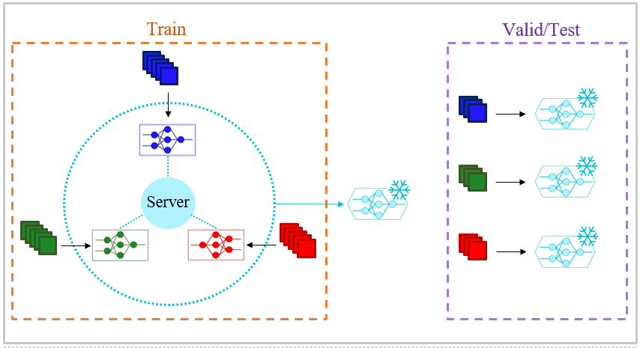
Learning Algorithms: Federated Learning

Slide 35
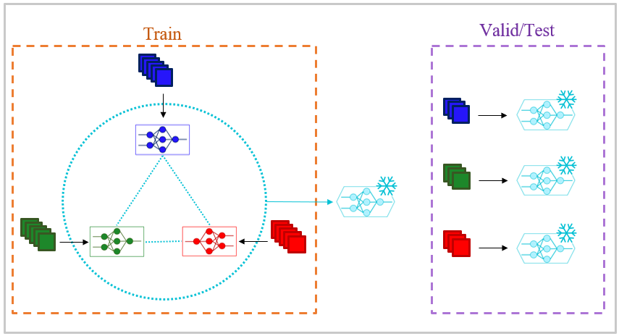
Learning Algorithms: Swarm Learning

Slide 36
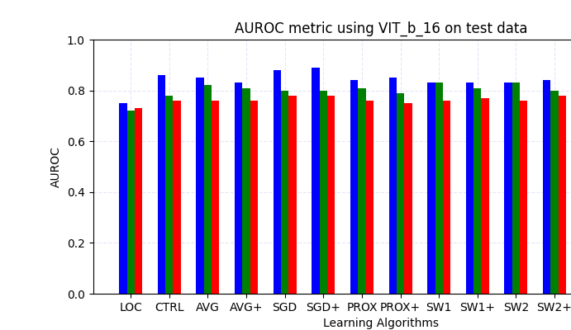
Learning Algorithms: Results
Datasets
AR (Argentina)
ISIC (International)
CL (Chile)

Slide 37
Multimodal Language Models

Slide 38

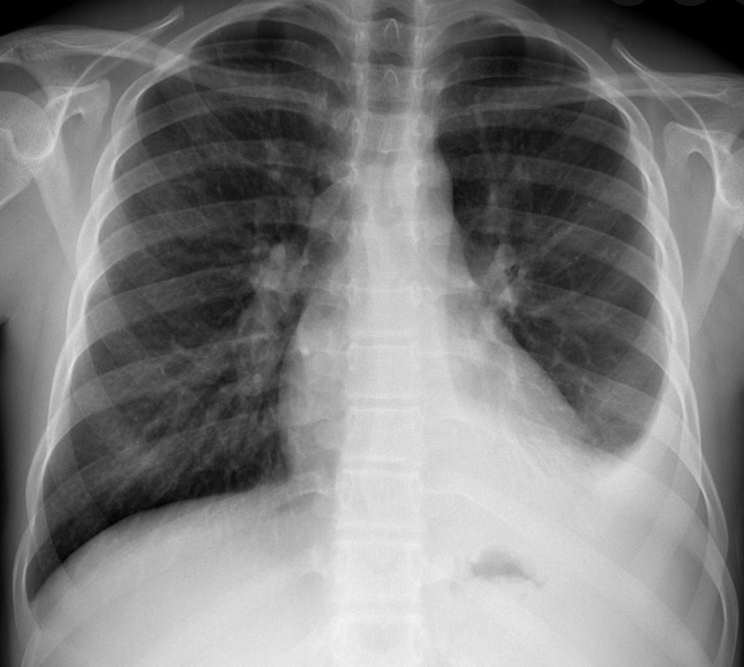

NLP + Computer Vision
> Can we use the Medical Reports to improve Computer Vision?
Computer Vision
Multimodal Model
Input: image
Reports

Slide 39
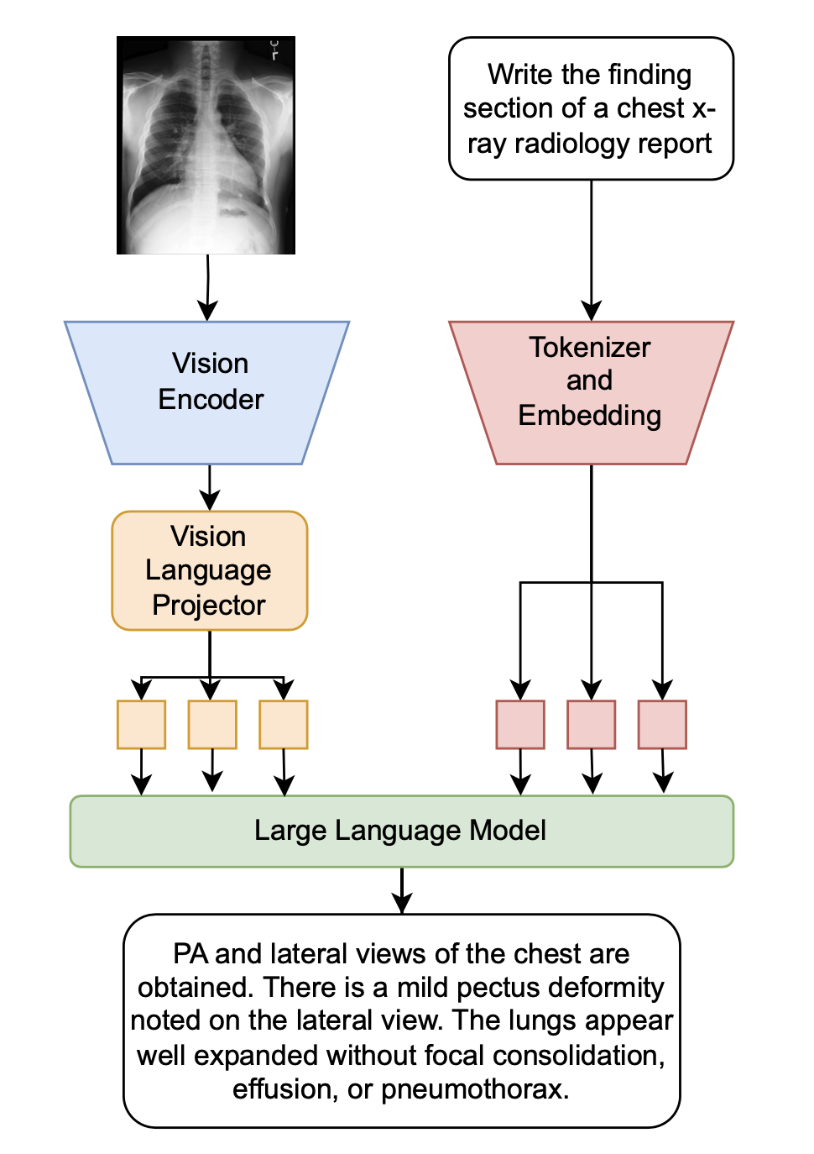
Learning and Finetuning of a Large
Multimodal Model for Radiology Report Generation
The Large Language Model (LLM) processes the features extracted from the image and the prompt
(c) Pablo Messina
Notes:
Campanini, D., Loch, O., Messina, P., Elberg, R., & Parra, D. (2024, August). iHealth-Chile-1 at RRG24: In-context Learning and Finetuning of a Large Multimodal Model for Radiology Report Generation. In Proceedings of the 23rd Workshop on Biomedical Natural Language Processing (pp. 608-613).

Slide 40
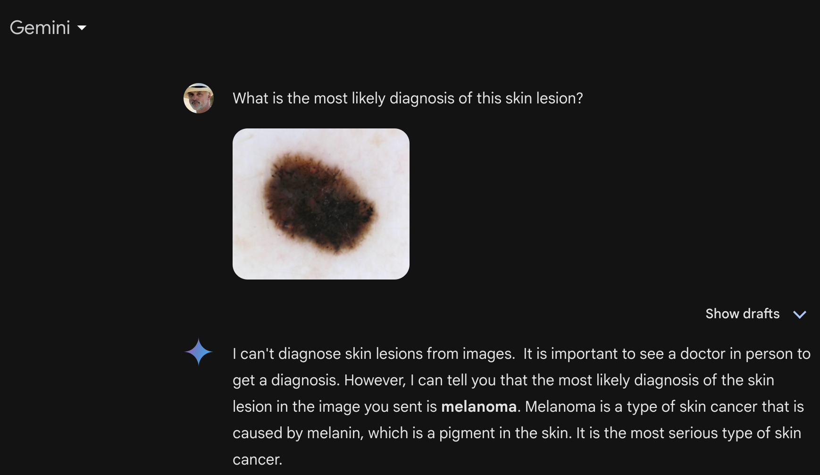

Slide 41
I can't diagnose skin lesions from images. It is important to see a doctor in person to get a diagnosis. However, I can tell you that the most likely diagnosis of the skin lesion in the image you sent is melanoma. Melanoma is a type of skin cancer that is caused by melanin, which is a pigment in the skin. It is the most serious type of skin cancer.

Slide 42
Implementation

Slide 43
IDEA
IMPLEMENTATION
EXPERIMENTS
© Andrew Ng, Machine Learning Yearning

Slide 44
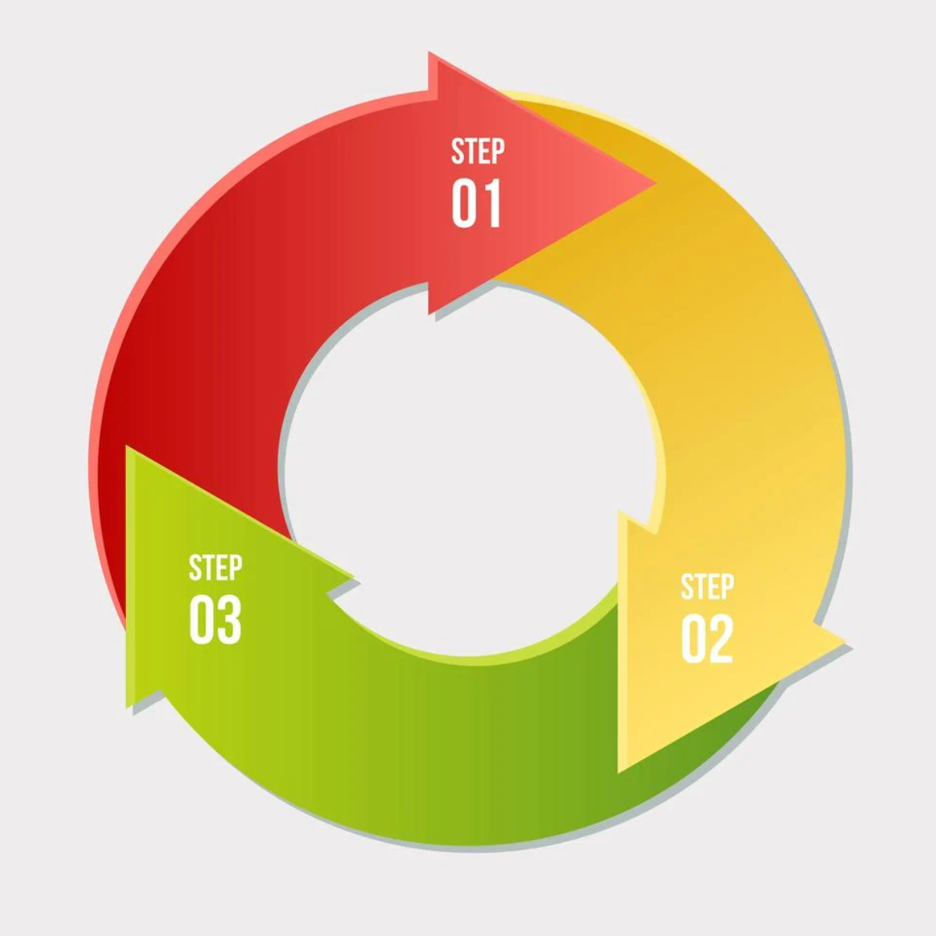
IDEA
Ethics?
Ethics?
IMPLEMENTATION
Ethics?
EXPERIMENTS
© Andrew Ng, Machine Learning Yearning

Slide 45
Data

Slide 46
Data
Results presented in many papers that work well on a specific dataset can vary significantly on other datasets.

Slide 47
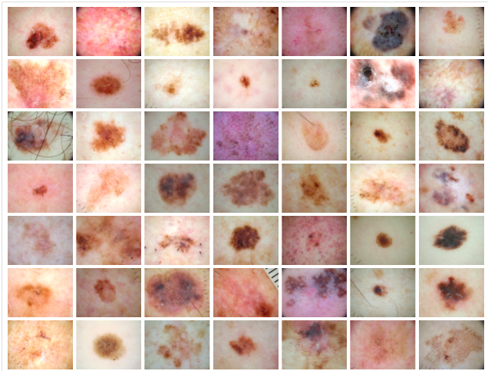
Data
Training and testing data is not enough.
We need large datasets (with ground truth diagnoses) with balanced classes, that fully represent all demographic groups.

Slide 48

Data
Latin-American Datasets:
Brazil
Argentina
Chile
Mexico

Slide 49
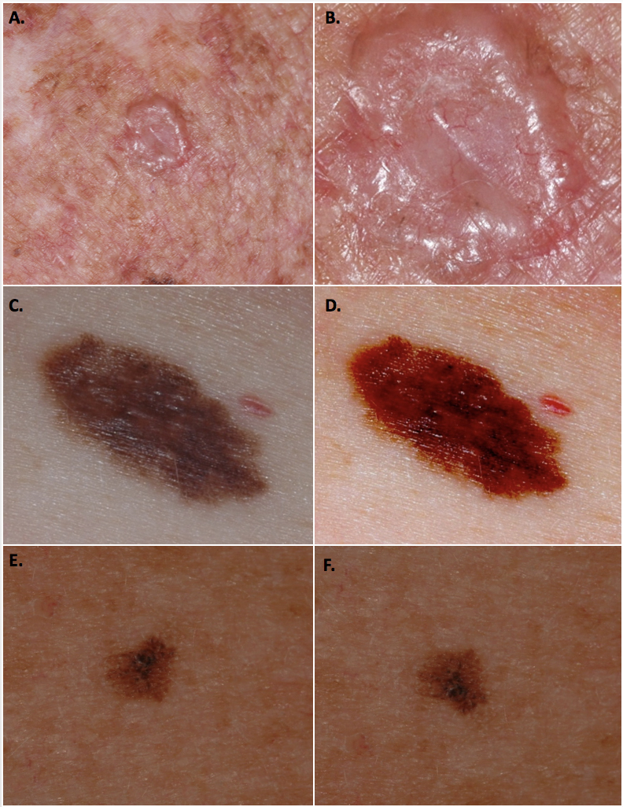
Effect of image zoom on diagnosis output
Lentigo (99.2%) Intraepithelial carcinoma (96.9%)
Notes:
Figure 1: Modification of the web app classification output by image manipulation. A-B: Basal cell carcinoma. The original image (A) was modified by zooming in (B). The 2 images gave different classifications: A. Lentigo (99.2% confidence). B. Intraepithelial carcinoma (96.9% confidence). C-D: Melanoma. The original image (C) was modified by changing the contrast and brightness settings (D). The 2 images gave different classifications: C. Melanoma (99% confidence). D. Hemangioma (98% confidence). E-F: Melanoma. The original image (E) was modified by flipping the image vertically (F). The 2 images gave different classifications: E. Lentigo (74% confidence), Melanoma (12% confidence), Nevus (5% confidence). F. Melanoma (40.5% confidence), Lentigo (32% confidence), Nevus (24% confidence).

Slide 50
Effect of image brightness/contrast on diagnosis output
Melanoma (99%) Hemangioma (98%)

Slide 51
Effect of image rotation on diagnosis output
Lentigo (74%) Melanoma (40.5%)

Slide 52
Ethics and Good Practices

Slide 53
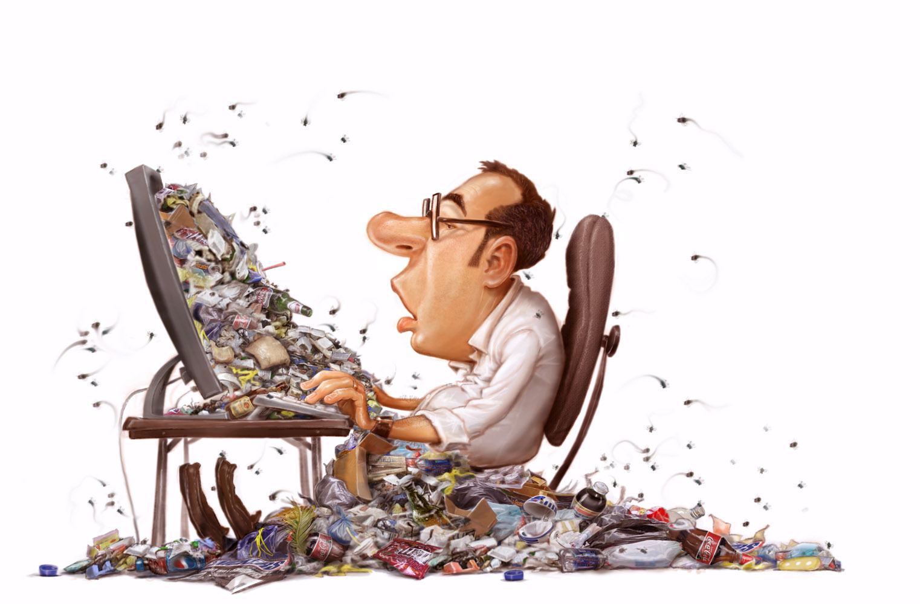
GIGO: Garbage in = Garbage out
If we train the models with poor quality data...
And if you know that your model is wrong, please don’t use it …
… don't expect good quality results
http://getgareth.github.io/2016/12/27/Garbage-in,-garbage-out.-A-developer-story.html

Slide 54

Sampling: Consider the demographics
If the problem is detecting a disease that affects men and women equally.

Slide 55
Sampling: Consider the demographics
Then include men and women in your dataset…

Slide 56
Sampling: Consider the demographics
Then include men and women in your dataset…

Slide 57
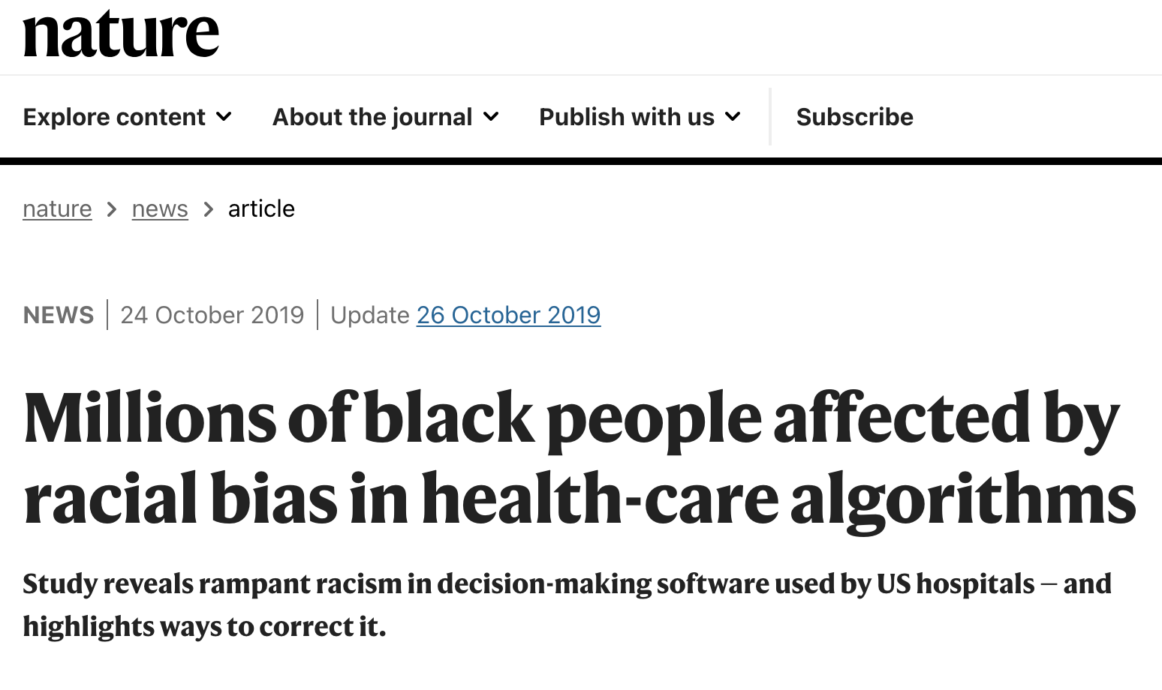
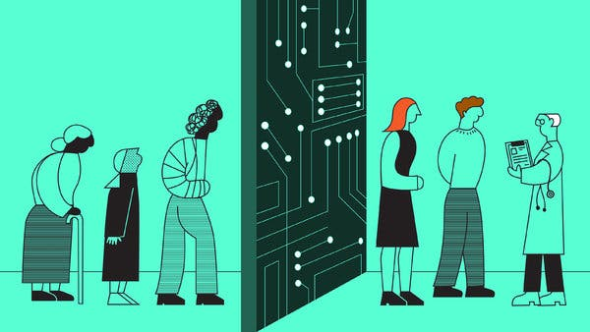
Sampling: Consider the demographics
https://www.nature.com/articles/d41586-019-03228-6
https://www.nytimes.com/2019/01/31/opinion/ai-bias-healthcare.html

Slide 58
Splitting: Consider disjunct groups

Slide 59

Splitting: Consider disjunct groups
1. SELECTION OF PEOPLE

Slide 60
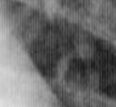
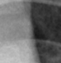
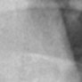
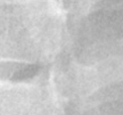
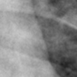
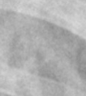
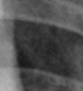
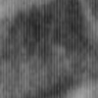
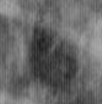
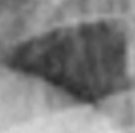
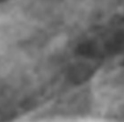
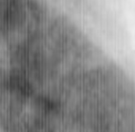
Splitting: Consider disjunct groups
1. SELECTION OF PEOPLE
2. ACQUISITION

Slide 61
Splitting: Consider disjunct groups
1. SELECTION OF PEOPLE
2. ACQUISITION

Slide 62
Splitting: Consider disjunct groups
1. SELECTION OF PEOPLE
2. ACQUISITION
3. RANDOMIZE

Slide 63
Splitting: Consider disjunct groups
1. SELECTION OF PEOPLE
2. ACQUISITION
3. RANDOMIZE
4. SPLITTING
TRAINING
TESTING

Slide 64
Splitting: Consider disjunct groups
1. SELECTION OF PEOPLE
2. ACQUISITION
3. RANDOMIZE
4. SPLITTING
TRAINING
TESTING
TYPICAL ACCURACY > 90%

Slide 65
Splitting: Consider disjunct groups
1. SELECTION OF PEOPLE
2. ACQUISITION
3. RANDOMIZE
4. SPLITTING
TRAINING
TESTING
TYPICAL ACCURACY > 90%

Slide 66
Splitting: Consider disjunct groups WHY ?
1. SELECTION OF PEOPLE
2. ACQUISITION
3. RANDOMIZE
4. SPLITTING
TRAINING
TESTING

Slide 67
Splitting: Consider disjunct groups
1. SELECTION OF PEOPLE
2. ACQUISITION

Slide 68
Splitting: Consider disjunct groups
1. SELECTION OF PEOPLE
2. ACQUISITION
3. RANDOMIZE PER SUBJECT

Slide 69

Splitting: Consider disjunct groups
1. SELECTION OF PEOPLE
2. ACQUISITION
3. RANDOMIZE PER SUBJECT
4. SPLITTING
TRAINING
TESTING
TYPICAL ACCURACY < 80%
OK

Slide 70
Generalization: Be representative

Slide 71
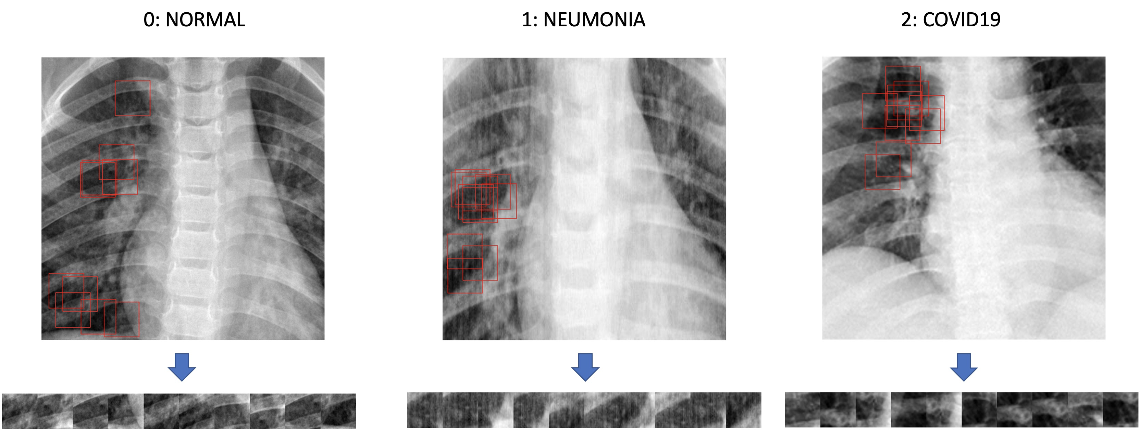
Image Classification – Example
COVID Detection with Rx
Classes →
1
2
3
4
N
N
N
N
Notes:
IDEA PRINCIPAL:
Extraer por cada radiografía N ‘ventanitas’ (patches) de las zonas oscuras.
Entrenar un clasificador que reconozca a qué clase peretenece cada patch.
Determinar a qué clase pertenece una radiografía a partir de la mayoría de votos de la clasificación individual de los patches.

Slide 72
Generalization: Be representative
HOSPITAL A
HOSPITAL B
TRAINING
MODEL

Slide 73
Generalization: Be representative
HOSPITAL A
HOSPITAL B
OK
TRAINING
MODEL

Slide 74
Resources

Slide 75
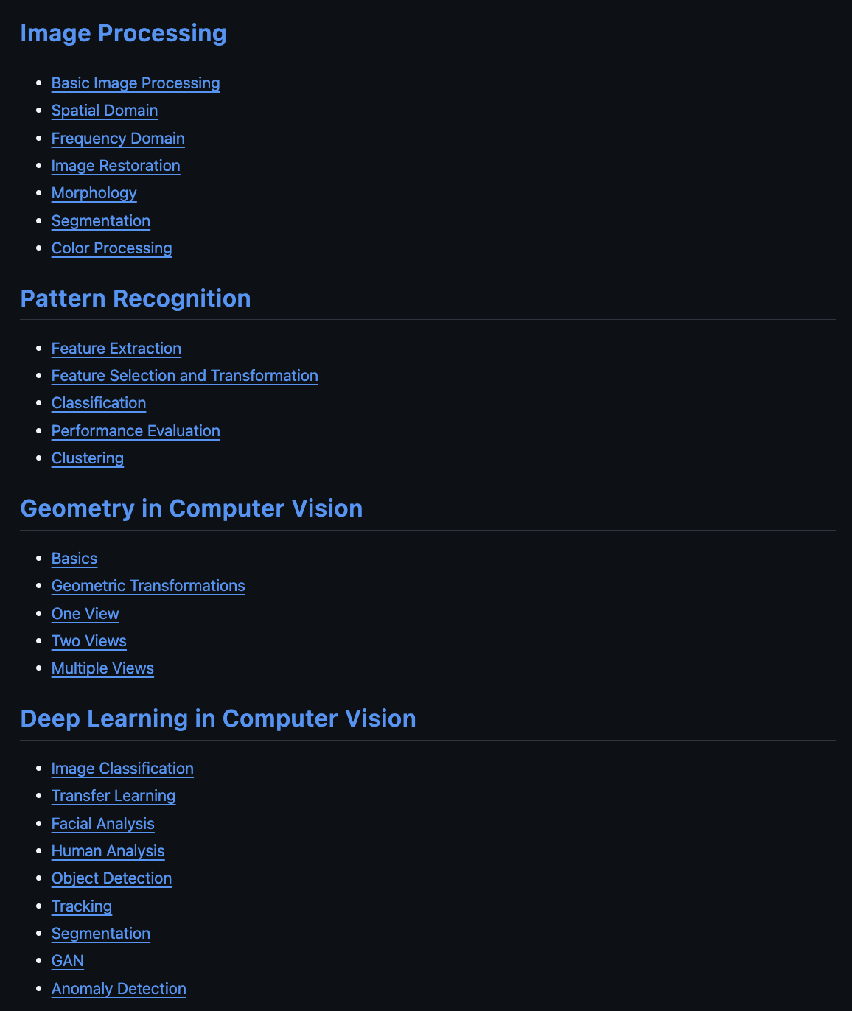

Code:
https://github.com/domingomery/visioncolab

Slide 76

Code:
https://github.com/domingomery/visioncolab

Slide 77

Code:
https://github.com/domingomery/visioncolab

Slide 78

Book:

Slide 79





Courses: YouTube, Coursera and GitHub

Slide 80


http://xcv.ing.puc.cl
http://domingomery.ing.puc.cl

